Slide 1
Idea
A total solution for the travelers.
Details of tourist attractions.
Transportation Fares
Easiest Routes
Nearby Hotels
Exciting tour packages for tourists.
Get help from the volunteers nearby.
Ask questions to a volunteer in a specific area
Get a tourist guide
Get cheap accommodation
Quick help in emergency situations
Get food suggestions and transportations

Slide 2





HOME
PLACES
PACKAGES
VOLUNTEERING
ASK A VOLUNTEER
Place Name
Transportation
Package Details
Find Volunteer
Become Volunteer
Query Form
Hotel Details
Cost
Search Places
Sign Up
Nearby Attractions
Duration
Volunteers List
Volunteers List
Package Comparison
Name
Contact Info

Slide 3
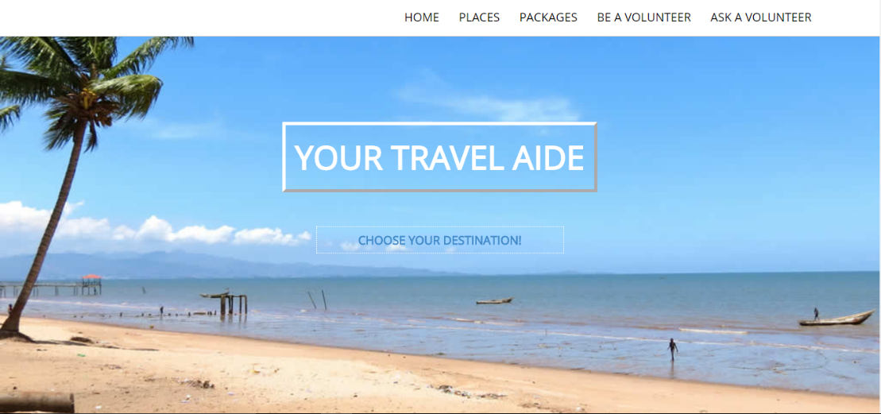
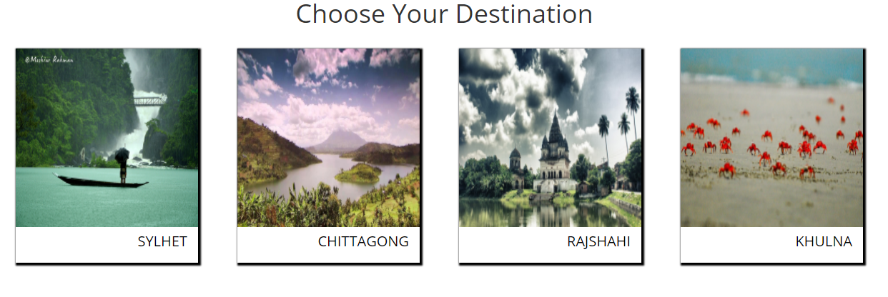
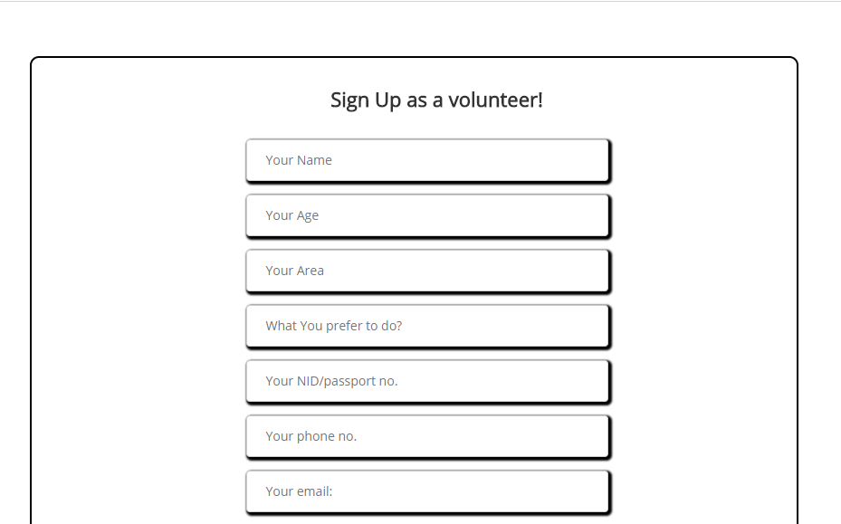
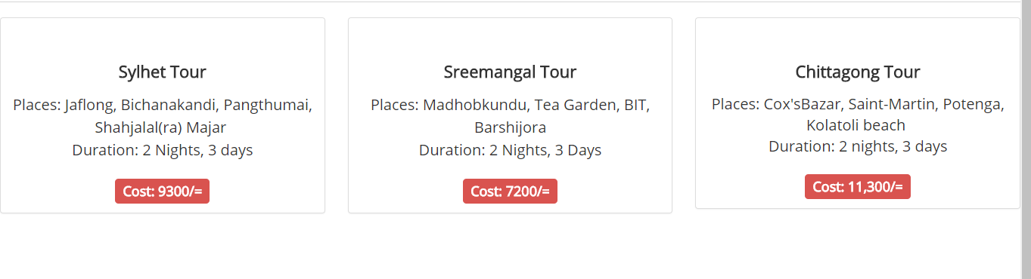
Screenshots

